Slide 1

Chapter 2
The OSI Model and the TCP/IP Protocol Suite
Copyright © The McGraw-Hill Companies, Inc. Permission required for reproduction or display.

Slide 2
OBJECTIVES:
To discuss the idea of multiple layering in data communication and networking and the interrelationship between layers.
To discuss the OSI model and its layer architecture and to show the interface between the layers.
To briefly discuss the functions of each layer in the OSI model.
To introduce the TCP/IP protocol suite and compare its layers with the ones in the OSI model.
To show the functionality of each layer in the TCP/IP protocol with some examples.
To discuss the addressing mechanism used in some layers of the TCP/IP protocol suite for the delivery of a message from the source to the destination.

Slide 3
Chapter
Outline
2.1 Protocol Layers
2.2 The OSI Model
2.3 TCP/IP Protocol Suite
2.4 Addressing

Slide 4
2-1 PROTOCOL LAYERS
In Chapter 1, we discussed that a protocol is required when two entities need to communicate. When communication is not simple, we may divide the complex task of communication into several layers. In this case, we may need several protocols, one for each layer.
Let us use a scenario in communication in which the role of protocol layering may be better understood. We use two examples. In the first example, communication is so simple that it can occur in only one layer.

Slide 5
Topics Discussed in the Section
Hierarchy
Services

Slide 6
Example 2.1
Assume Maria and Ann are neighbors with a lot of common ideas. However, Maria speaks only Spanish, and Ann speaks only English. Since both have learned the sign language in their childhood, they enjoy meeting in a cafe a couple of days per week and exchange their ideas using signs. Occasionally, they also use a bilingual dictionary. Communication is face to face and Happens in one layer as shown in Figure 2.1.

Slide 7
Figure 2.1 Example 2.1

Slide 8
Example 2.2
Now assume that Ann has to move to another town because of her job. Before she moves, the two meet for the last time in the same cafe. Although both are sad, Maria surprises Ann when she opens a packet that contains two small machines. The first machine can scan and transform a letter in English to a secret code or vice versa. The other machine can scan and translate a letter in Spanish to the same secret code or vice versa. Ann takes the first machine; Maria keeps the second one. The two friends can still communicate using the secret code, as shown in Figure 2.2.

Slide 9
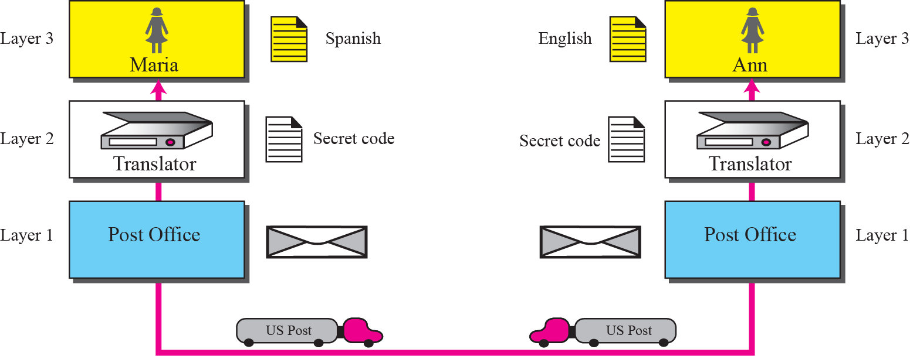
Figure 2.2 Example 2.2

Slide 10
2-2 THE OSI MODEL
Established in 1947, the International Standards Organization (ISO) is a multinational body dedicated to worldwide agreement on international standards. Almost three-fourths of countries in the world are represented in the ISO. An ISO standard that covers all aspects of network communications is the Open Systems Interconnection (OSI) model. It was first introduced in the late 1970s.

Slide 11
Topics Discussed in the Section
Layered Architecture
Layer-to-layer Communication
Encapsulation
Layers in the OSI Model
Summary of OSI Layers

Slide 12

Note
ISO is the organization;
OSI is the model.

Slide 13
OSI 模型
结构：分层的框架结构
目的：设计出能够让各种类型的计算机系统相互通信的网络系统
组成：7个独立且相关的层，每层完成网络信息传输功能的一部分

Slide 14
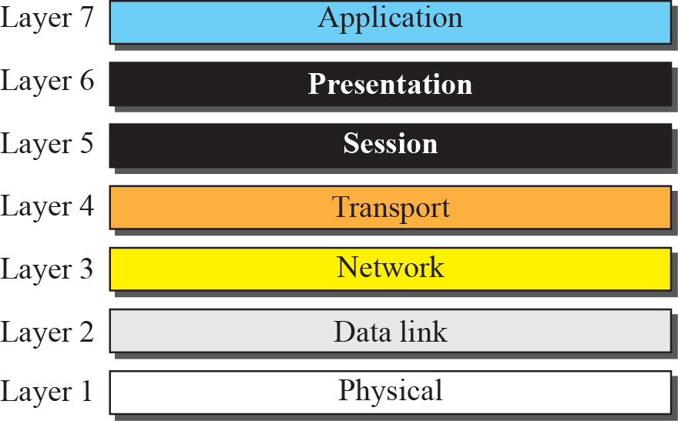
Figure 2.3 The OSI model

Slide 15
分层模型重要概念
1.服务
下层为上层服务(无连接、面向连接)
2.接口
下层为上层服务的入口
3.封装
上层协议单元被封装在下层协议载荷中

Slide 16

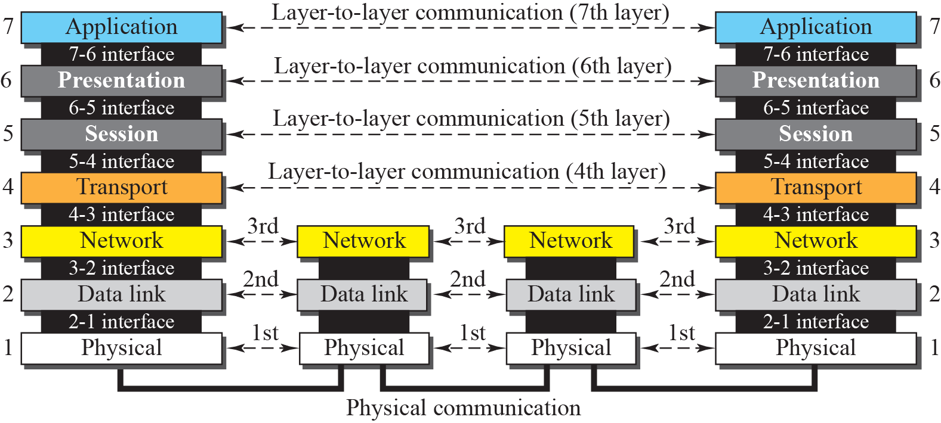
Figure 2.4 OSI layers

Slide 17
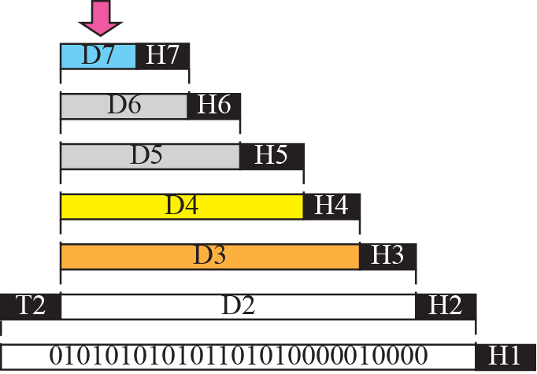


Figure 2.5 An exchange using the OSI model

Slide 18
物理层
功能：比特流在物理媒介(或媒体)中传输
  接口和媒介的物理特性
  信号编码：比特的表示
  数据传输速率
  比特的同步
  线路配置
  物理拓扑
  传输方式：单工、半双工、全双工

Slide 19
Note
The physical layer is responsible for moving individual bits from one
(node) to the next.

Slide 20
数据链路层
功能：将物理层转换为可靠的链路
  组帧
  物理编址
  流量控制
  差错控制
  接入控制

Slide 21
网络层
功能：将分组从源节点交付到目的节点
  逻辑编址
  拓扑发现
  路由选择
  分组转发

Slide 22
运输(或传输)层
功能：进程到进程的报文交付
  服务点编址
  分段与重装
  连接控制
  流量控制
  拥塞控制
  差错控制

Slide 23
会话层
功能：对话控制
  对话控制
  同步

Slide 24
表示层
功能：信息的语法和语义
  转换
  加密
  压缩

Slide 25
应用层
功能：让用户方便使用网络
  各种常用网络服务，如email,www等

Slide 26
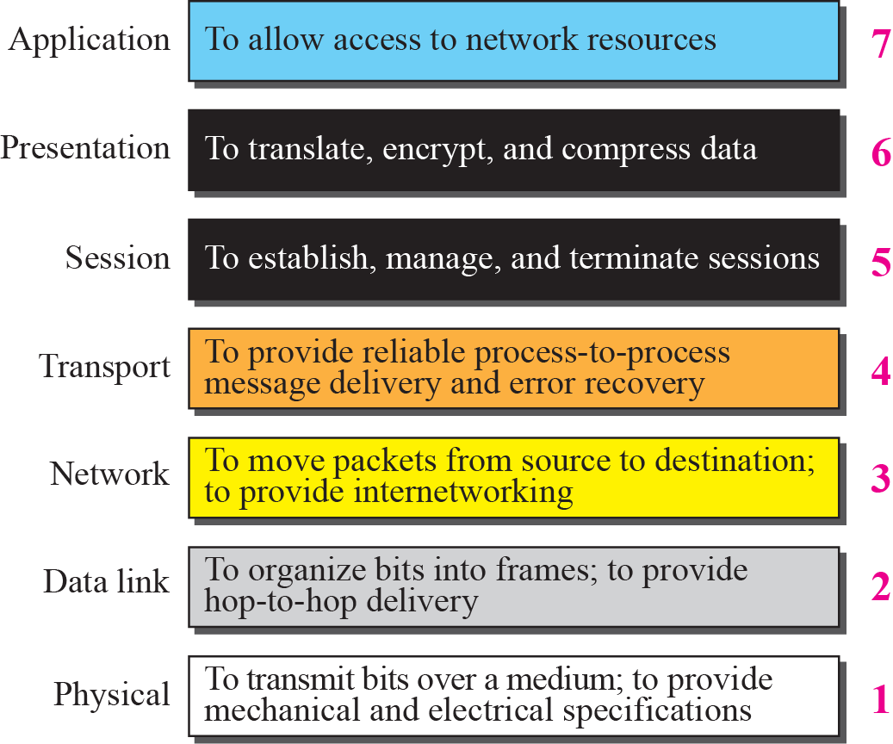
Figure 2.6 Summary of OSI Layers

Slide 27
2-3 TCP/IP PROTOCOL SUITE
The TCP/IP protocol suite was developed prior to the OSI model. Therefore, the layers in the TCP/IP protocol suite do not match exactly with those in the OSI model. The original TCP/IP protocol suite was defined as four software layers built upon the hardware. Today, however, TCP/IP is thought of as a five-layer model with the layers named similarly to the ones in the OSI model. Figure 2.7 shows both configurations.

Slide 28
Topics Discussed in the Section
Comparison between OSI and TCP/IP
Layers in the TCP/IP Suite

Slide 29
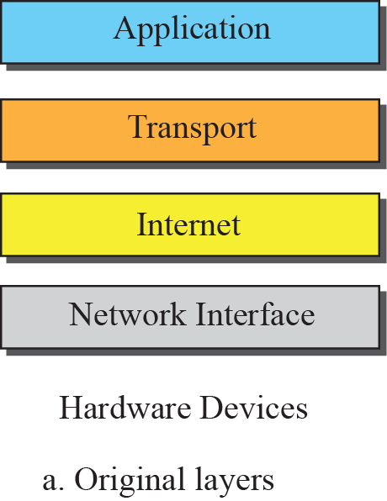
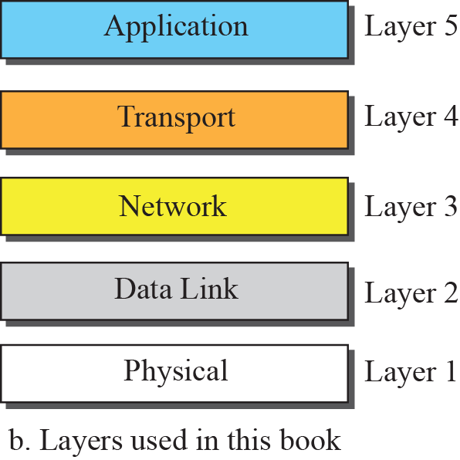
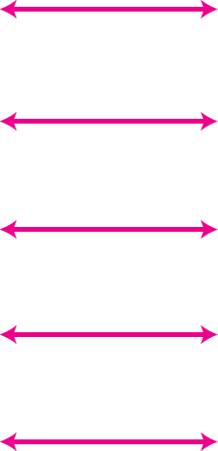
Figure 2.7 Layers in the TCP/IP Protocol Suite

Slide 30
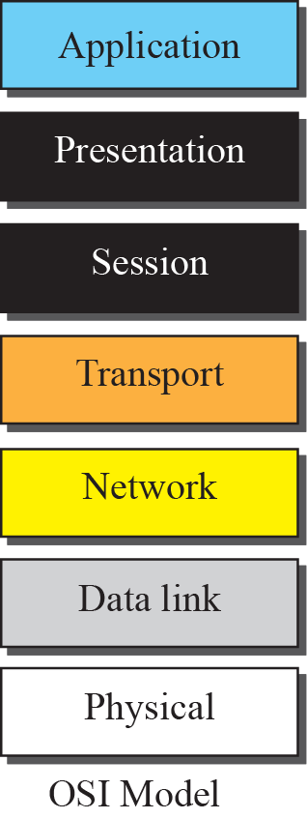
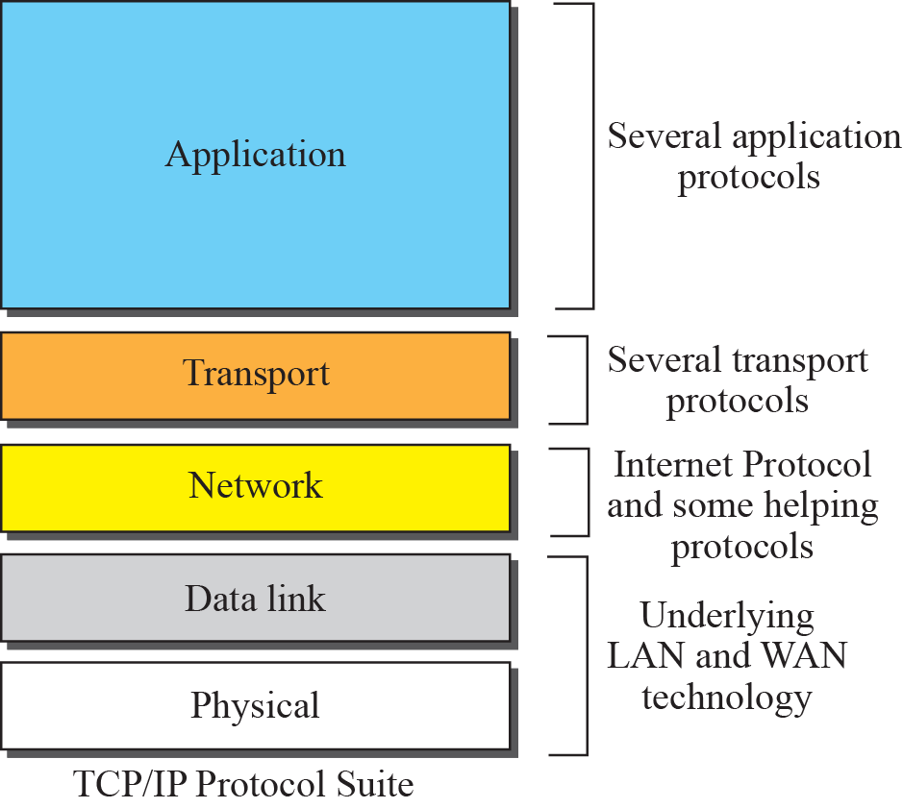
Figure 2.8 TCP/IP and OSI model

Slide 31
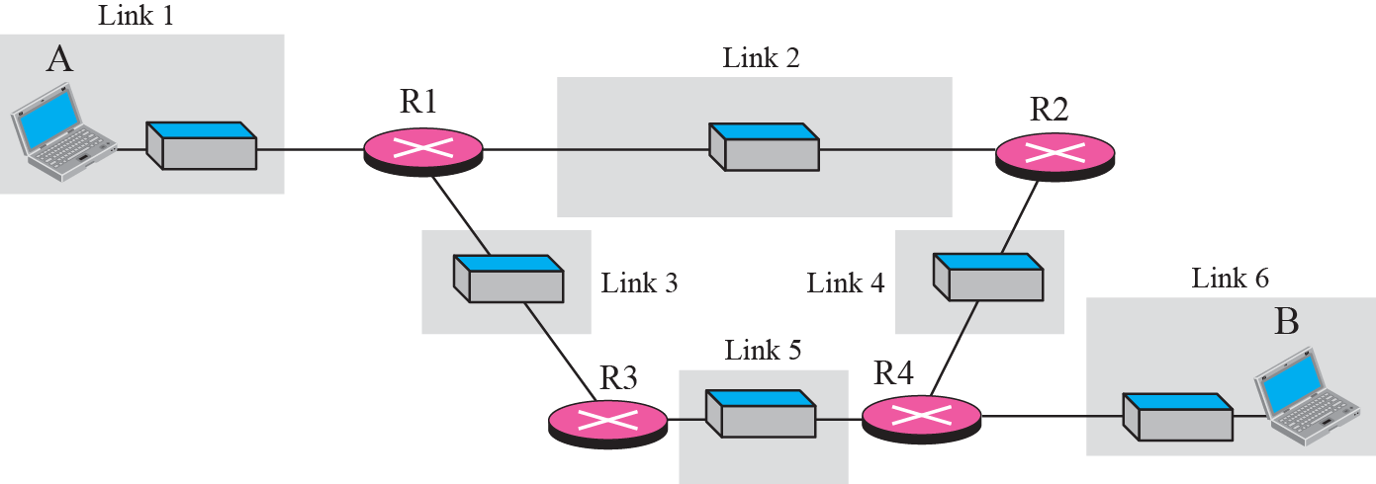
Figure 2.9 A private internet

Slide 32
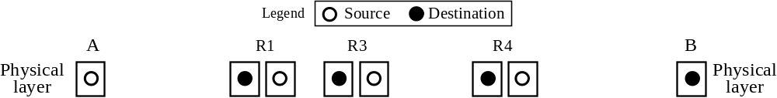





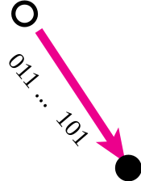


Figure 2.10 Communication at the physical layer

Slide 33
Note
The unit of communication at the physical layer is a bit.

Slide 34
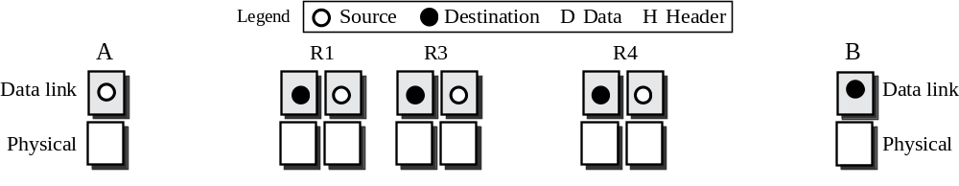
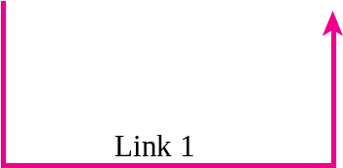
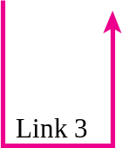
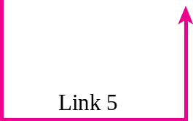
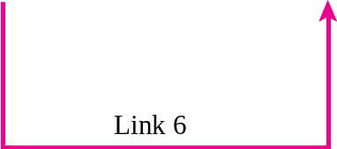
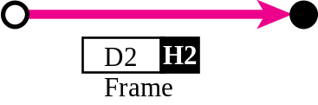
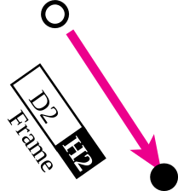
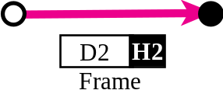
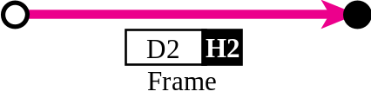
Figure 2.11 Communication at the data link layer

Slide 35
Note
The unit of communication at the data link layer is a frame.

Slide 36
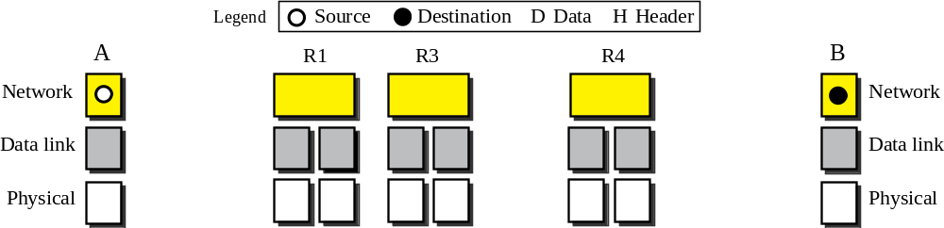

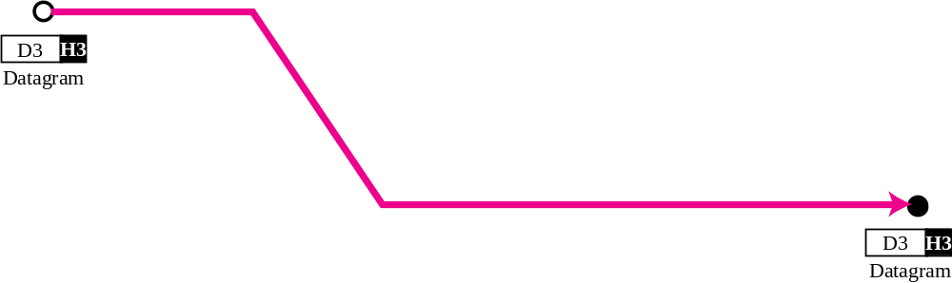
Figure 2.12 Communication at the network layer

Slide 37
Note
The unit of communication at the network layer is a datagram.

Slide 38
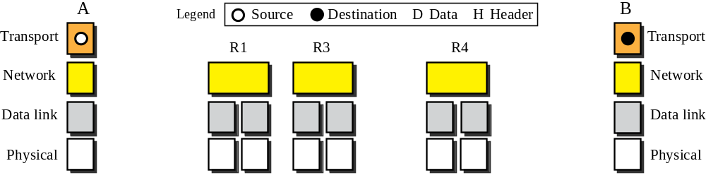
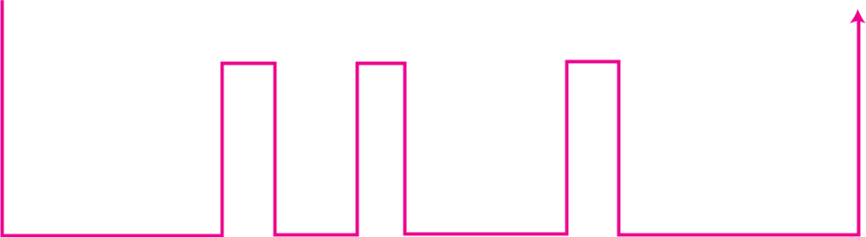
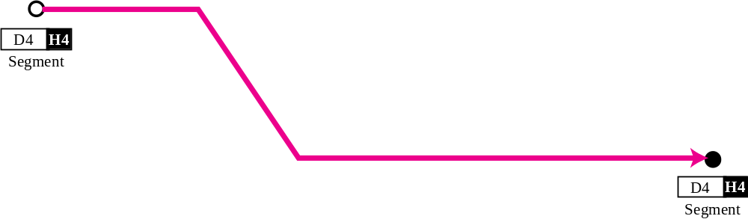
Figure 2.13 Communication at transport layer

Slide 39
Note
The unit of communication at the transport layer is a segment, user datagram, or a packet, depending on the specific protocol used in this layer.

Slide 40
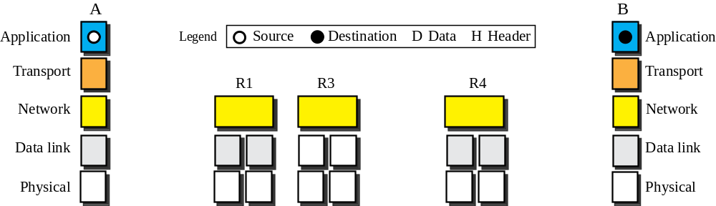
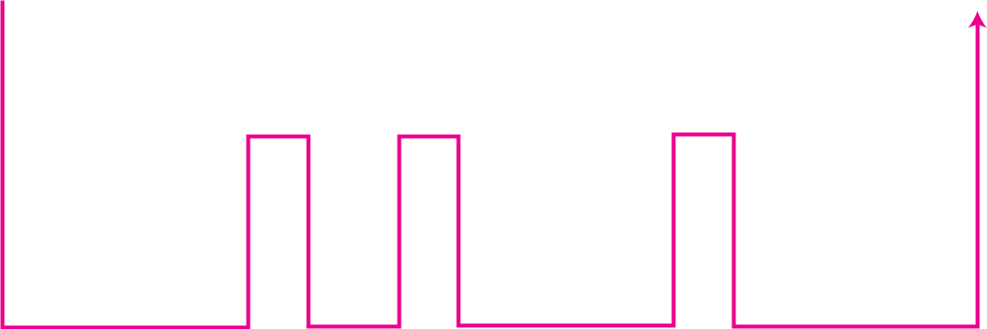
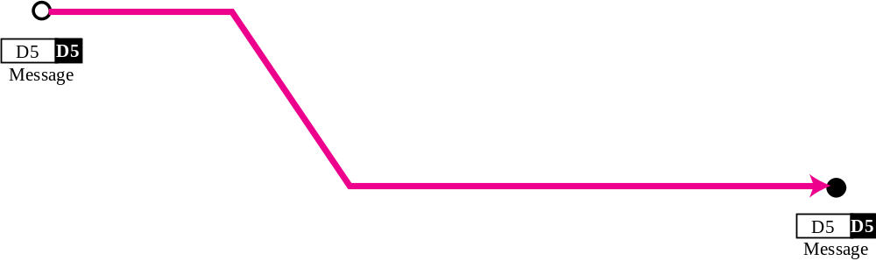
Figure 2.14 Communication at application layer

Slide 41
Note
The unit of communication at the application layer is a message.

Slide 42
2-4 ADDRESSING
Four levels of addresses are used in an internet employing the TCP/IP protocols: physical address, logical address, port address, and application-specific address. Each address is related to a one layer in the TCP/IP architecture, as shown in Figure 2.15.

Slide 43
Topics Discussed in the Section
Physical Addresses
Logical Addresses
Port Addresses
Application-Specific Addresses

Slide 44
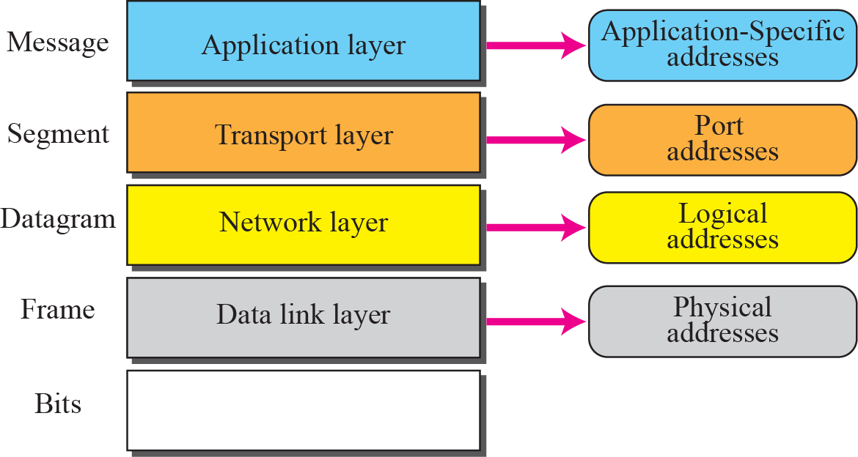
Figure 2.15 Addresses in the TCP/IP protocol suite

Slide 45
物理地址
网络节点链路层地址(通常为硬件地址)。仅对链路层(局域网或广域网)有效。

Slide 46
Example 2.3
In Figure 2.16 a node with physical address 10 sends a frame to a node with physical address 87. The two nodes are connected by a link (a LAN). At the data link layer, this frame contains physical (link) addresses in the header. These are the only addresses needed. The rest of the header contains other information needed at this level. As the figure shows, the computer with physical address 10 is the sender, and the computer with physical address 87 is the receiver. The data link layer at the sender receives data from an upper layer. It encapsulates the data in a frame. The frame is propagated through the LAN. Each station with a physical address other than 87 drops the frame because the destination address in the frame does not match its own physical address. The intended destination computer, however, finds a match between the destination address in the frame and its own physical address.

Slide 47
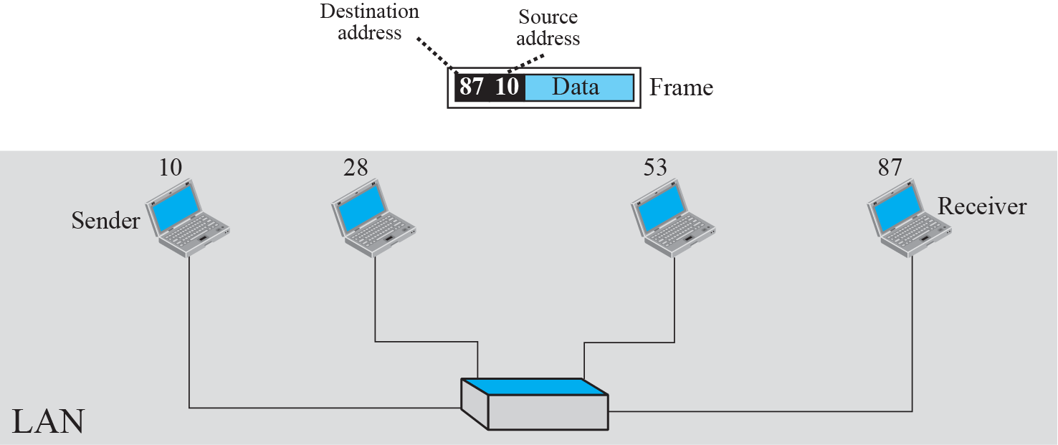
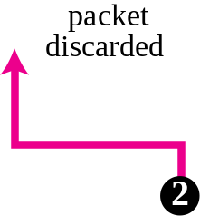
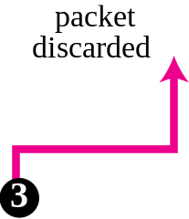
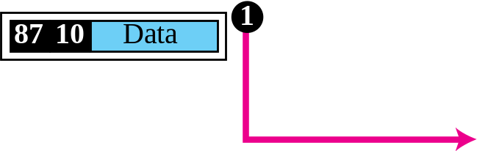
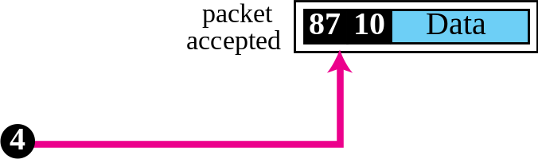
Figure 2.16 Example 2.3: physical addresses

Slide 48
Example 2.4
As we will see in Chapter 3, most local area networks use a 48-bit (6-byte) physical address written as 12 hexadecimal digits; every byte (2 hexadecimal digits) is separated by a colon, as shown below:
07:01:02:01:2C:4B
A 6-byte (12 hexadecimal digits) physical address

Slide 49
逻辑地址
逻辑地址是网络层地址，用来唯一地标志连接在Internet上的第一台主机
逻辑地址是全局性地址，与底层的物理网络无关

Slide 50
Example 2.5
Figure 2.17 shows a part of an internet with two routers connecting three LANs. Each device (computer or router) has a pair of addresses (logical and physical) for each connection. In this case, each computer is connected to only one link and therefore has only one pair of addresses. Each router, however, is connected to three networks. So each router has three pairs of addresses, one for each connection. Although it may be obvious that each router must have a separate physical address for each connection, it may not be obvious why it needs a logical address for each connection. We discuss these issues in Chapters 11 and 12 when we discuss routing. The computer with logical address A and physical address 10 needs to send a packet to the computer with logical address P and physical address 95. We use letters to show the logical addresses and numbers for physical addresses, but note that both are actually numbers, as we will see in later chapters.

Slide 51
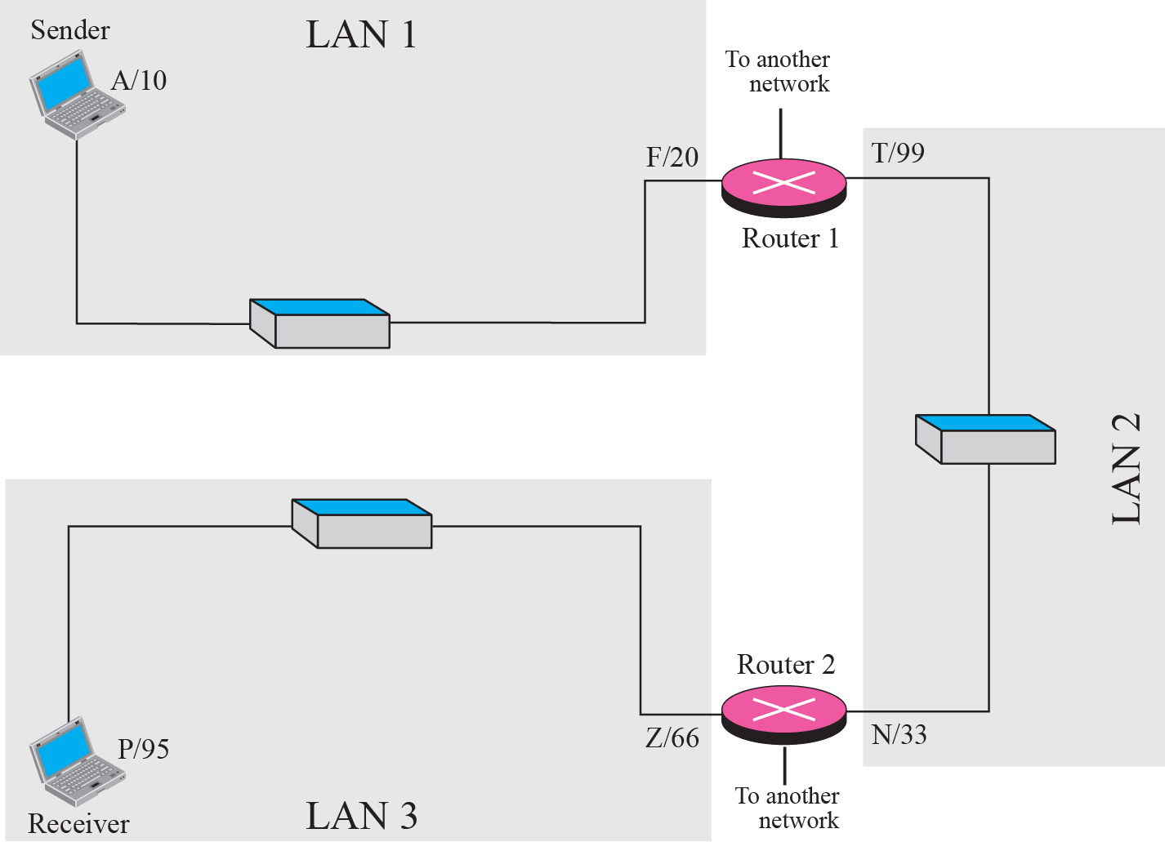
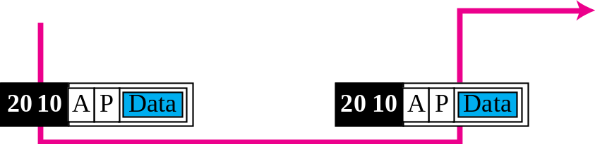
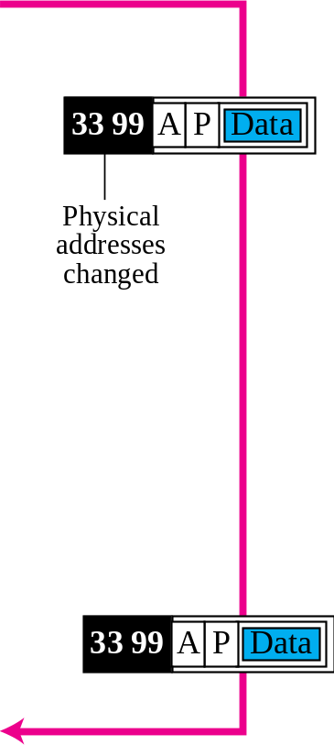
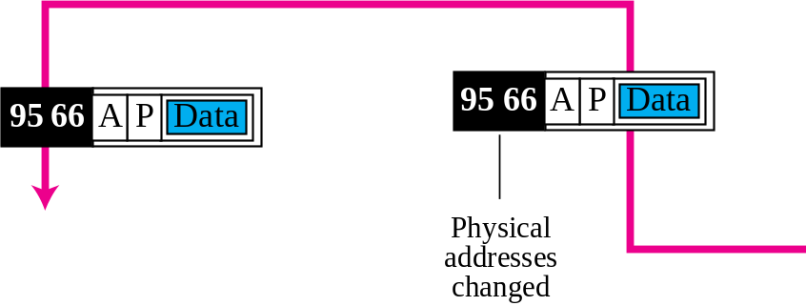
Figure 2.17 Example 2.5: logical addresses

Slide 52
Note
The physical addresses will change from hop to hop, but the logical addresses remain the same.

Slide 53
端口地址
用于区别同一台主机中的不同进程

Slide 54
Example 2.6
Figure 2.18 shows two computers communicating via the Internet. The sending computer is running three processes at this time with port addresses a, b, and c. The receiving computer is running two processes at this time with port addresses j and k. Process a in the sending computer needs to communicate with process j in the receiving computer. Note that although both computers are using the same application, FTP, for example, the port addresses are different because one is a client program and the other is a server program, as we will see in Chapter 17.

Slide 55
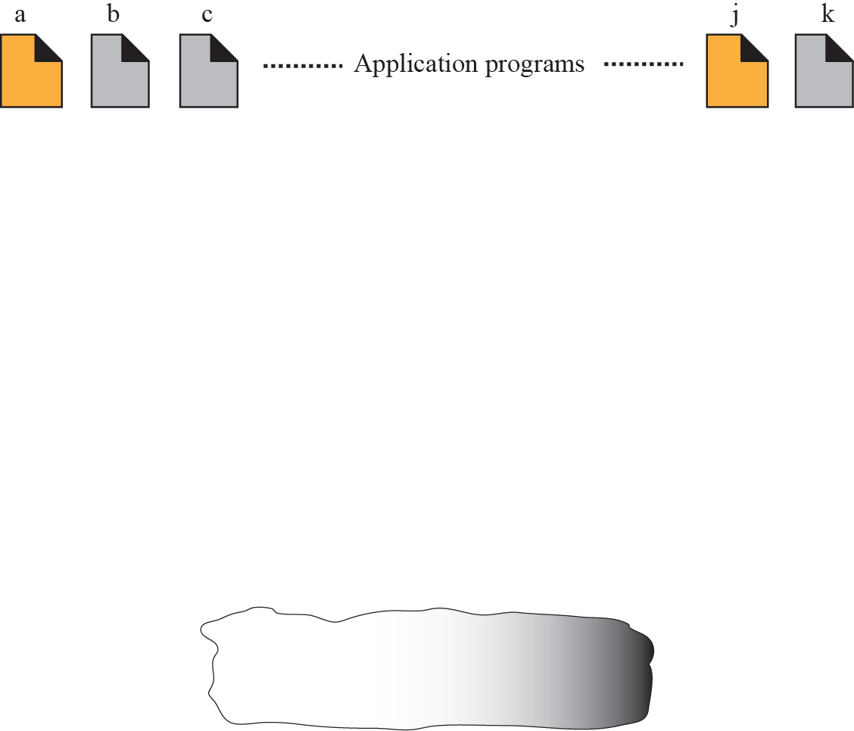
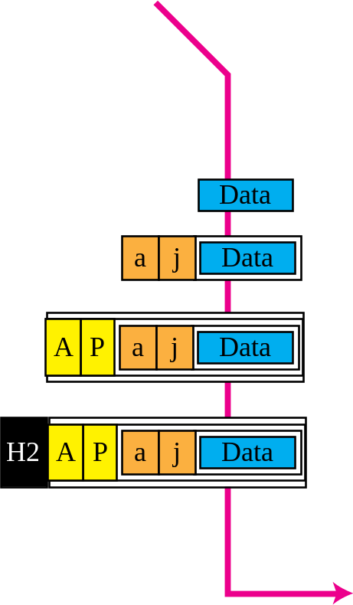
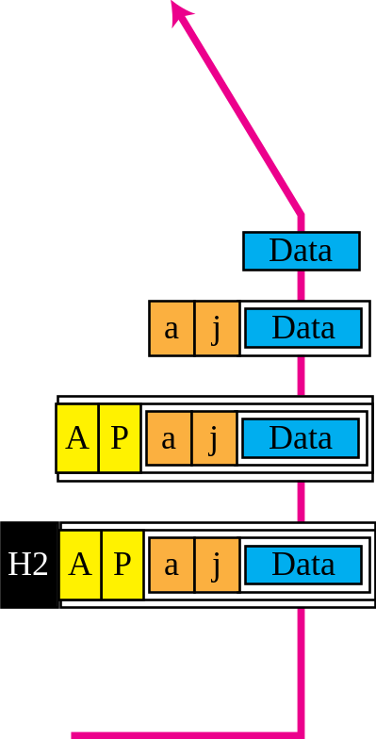


Figure 2.18 Example 2.6: port numbers

Slide 56
Note
The physical addresses change from hop to hop, but the logical and port addresses usually remain the same.

Slide 57
Example 2.7
As we will see in future chapters, a port address is a 16-bit address represented by one decimal number as shown.
753
A 16-bit port address represented as one single number

Slide 58
特定应用地址
如email地址、URL等

